Slide 1

ITC 6000 Database Management Systems Final Project Presentation 2022 Spring B Grocery Management System
Jalajakshi Channabasappa Lali
lali.j@northeastern.edu

Slide 2

Project Overview
The project I have worked on is Grocery Management System. In this project I have attempted to create an app with 1 tiered client server architecture which can be used to fetch the reports and get an overview of the Grocery Store
Personal Connection
Getting groceries from stores by visiting them physically is cumbersome and overwhelming
As a customer, I have observed that I get a different product when the particular product I ordered is stocked out
Creating a dynamic grocery management system can mitigate these minor inconveniences and make business process efficient
Grocery Management System tracks:
Customer Orders
Customer Engagement
Product Inventory
Payment transactions

Slide 3
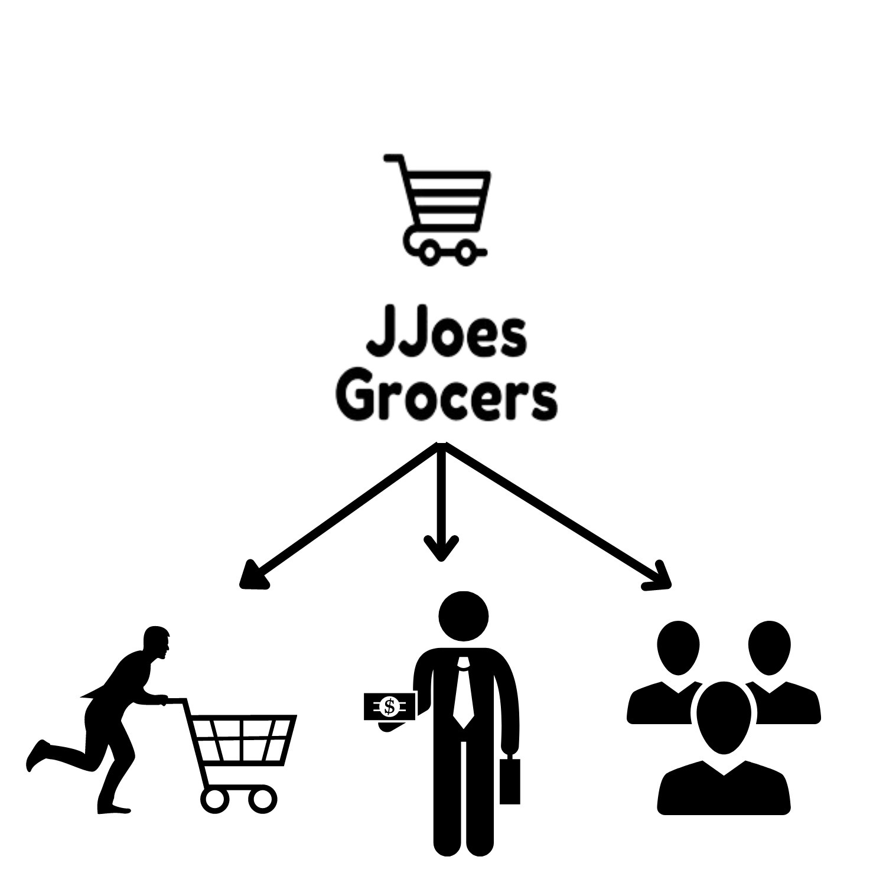
User Personas
Customer
Administrator/Owner
Employee
App Cost Model
Database Creation and Maintenance
Local Hosting
RAM requirements less than 4GB
Freemium Model

Slide 4
Persona Use Cases
Customer
App subscription
Check products availability
Order multiple products
Admin
Track customer orders
Track customer management
Check product availability in inventory
Allot employee tasks
Employee
Check order details
Work on orders and update when completed

Slide 5
Table Design and Analysis
Tables: Customer, Admin, Membership Card, Product, Employee, Payment, Sales
The Customer is the primary user. The details of registered customer will be stored in customer table
The product details available in grocery store can be fetched from product table. The admin can access the product stock details from this table.
The details filled by employees in employment form will be loaded into Employee table
Owner/Admin is the super user and admin has the privilege to access and manipulate data in these tables
On registering, the customer can take the subscription. The registered users with subscription will get a membership card. The details of this card will be stored in Membership Card details table
On purchase of products, the sales table will be updated, with details of customer id, product, quantity of products, and purchase date
After every transaction, payment table will be updated for every Sales

Slide 6
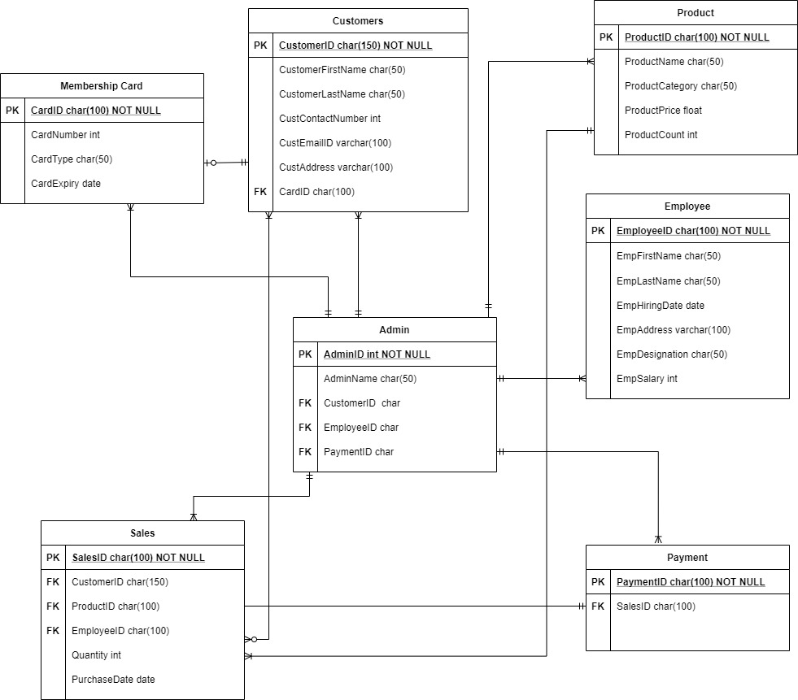
ERD

Slide 7
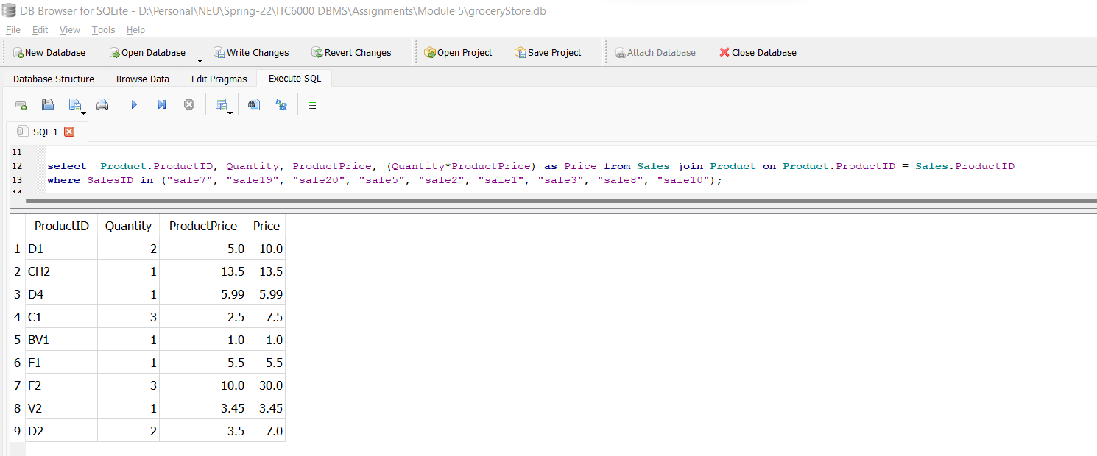
SQL Queries
Total Price of a Sales

Slide 8
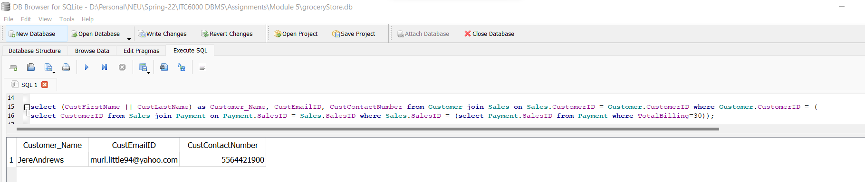
SQL Queries
Customer details who made purchase of 30 USD

Slide 9
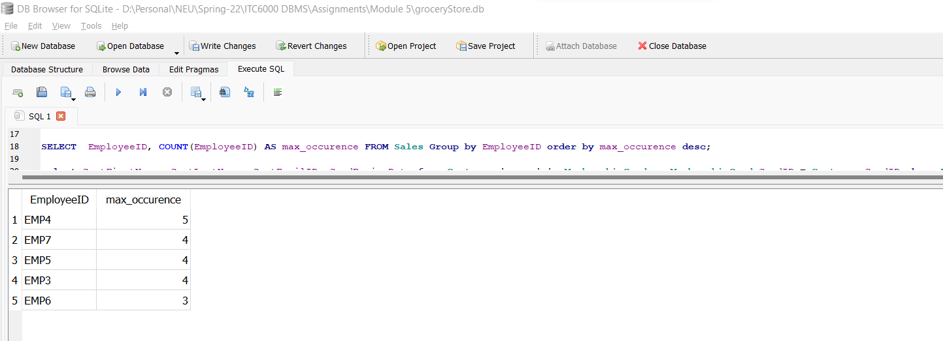
SQL Queries
Employee Work Frequency

Slide 10
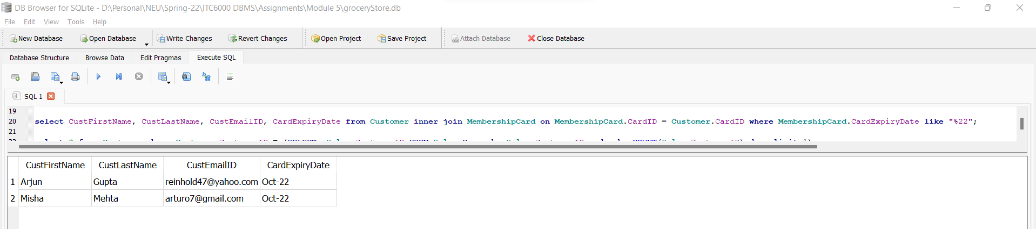
SQL Queries
Customer details owning card with expiry date in 2022

Slide 11
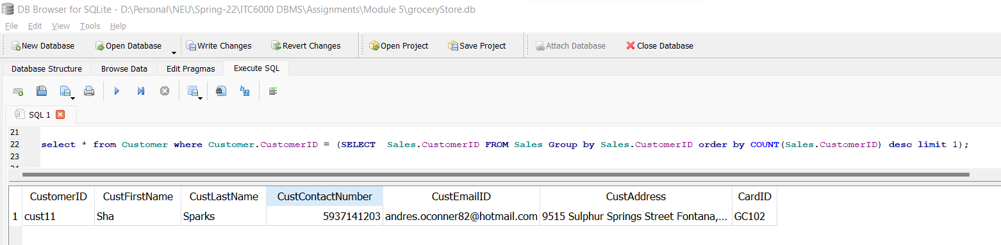
SQL Queries
Returning Customer Details

Slide 12
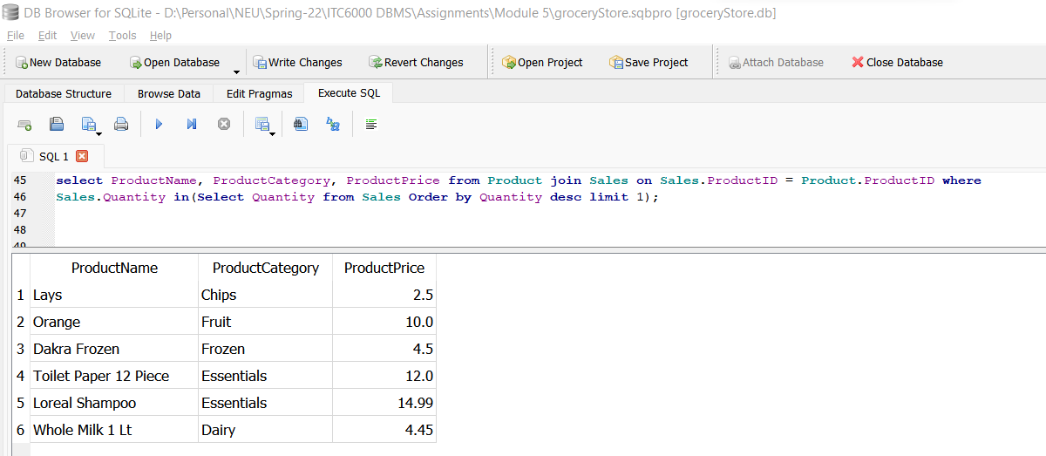
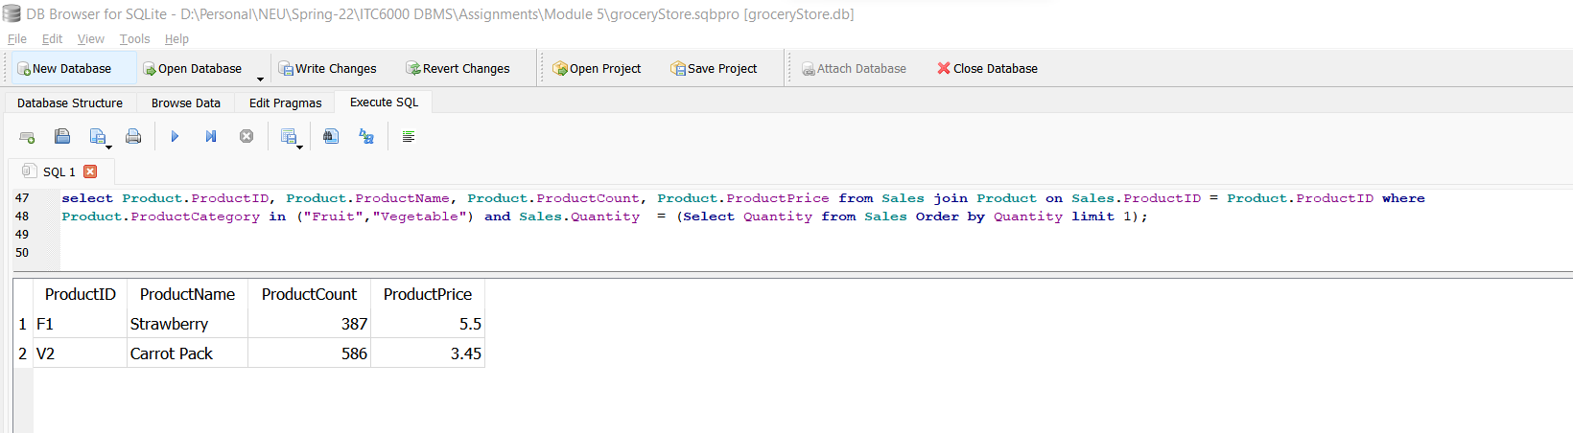
Analytics, Reports and Metrics
Most Revenue Generating Products
Low Selling Fruits and Vegetables

Slide 13
Security Concerns and Protection
A data breach exposes sensitive, private, or protected data to an uninvited party
Vulnerability Causes:
Weak credentials
Stolen credentials
Compromised assets
Third-party access
Practices to avoid data breach
High-grade encryption
Enforcing strong credentials
Educating employees
Security Concerns in the Project
-Membership Card Details
-Protection of Customer Sensitive Information

Slide 14
Project Wrap Up
Through this project I was able to build database based on single tier architecture which can be used to fetch reports
I have learnt to work on SQL queries and understand the concept of Primary Key and Foreign Key usage
Data can be loaded into tables by importing csv files
Using join the information from multiple tables can be fetched at once
In future, the application can be migrated to three tiered architecture with clear segregation between front end and back end

